Slide 1

Knowledge Driven Framework
Foundation for Delivering Healthcare Services

Slide 2

Overview
Key trends in Life Sciences & Healthcare
Knowledge will play a key role in the future
Positioning Knowledge in our portfolio
Examining KM w/in our current products
Examining KM w/in our future products
Proposal: Knowledge Driven Healthcare
Opportunities for delivering value
A few challenges

Slide 3
Key Trends in Life Sciences & Healthcare
The pace of change is accelerating (constantly)
The ability to manage change faster is becoming a core competency (agility)
The ability to minimize impact from change is becoming a priority (adaptability)
The transition of control & knowledge from healthcare to patients is accelerating
The shift in research from passive to active healthcare is already happening (disruption)
Life sciences are moving towards singularity with the infusion of technology (doubling every 2 years)

Slide 4
Knowledge will play a key role in the future
Currently, we use knowledge as a supplemental asset to support the delivery of products.
In the not too distant future, knowledge will be positioned as the keystone for our product & services
What’s the basis for this statement ?
  Collaboration is evolving into a core competency in healthcare
    human to human (caregivers, patients, supply chain verticals – not just healthcare)
    human to product (device now & eventually drug – think nano)
    Product to product (machines now & drugs eventually)
  Collaboration is supported by knowledge

Slide 5
What is meant by the term “knowledge” ?
Knowledge is information that is presented in a readily consumable format for a resource* to leverage:
  To support short-term decision making
  To support long-term decision making
  To share with other resources
  * humans, products, assets (and any subset thereof)
A few myths to dismiss:
  Data by itself is not knowledge
  Content by itself is not knowledge

Slide 6
How do we position knowledge ?
First, let’s consider the end state that we would like to achieve before we tackle how we should position knowledge.
Proposed: End State Vision for Knowledge
  Any resource can capture and share knowledge
  Access to knowledge is transparent
  Capture of knowledge is seamless
  The 5 rights for knowledge sharing:
    Right knowledge
    Right format
    Right amount
    Right timing
    Right resources

Slide 7
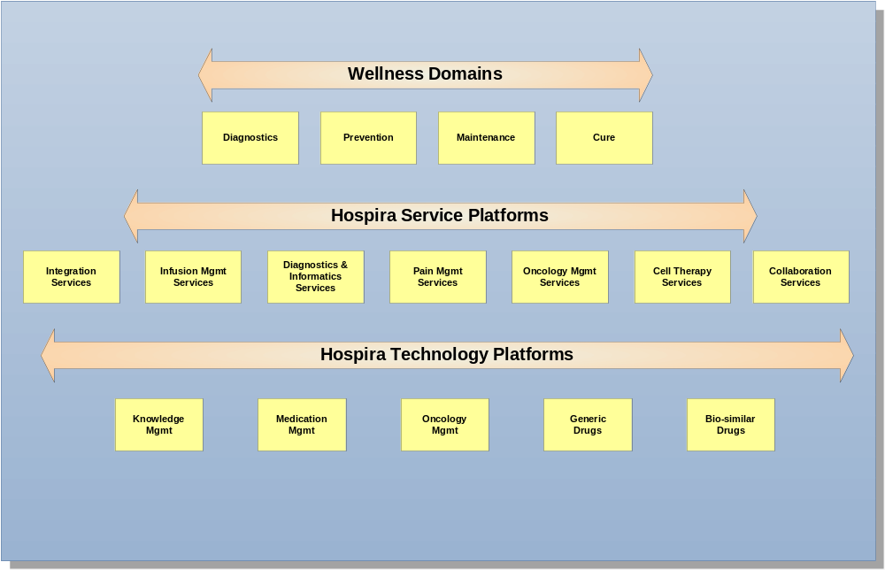
Positioning Knowledge in our portfolio

Slide 8
Examining KM w/in our current products
Drug & Device product lines are managed in separate silos on separate roadmaps.
Collaboration between the 2 product families is minimal.
Device product line is built on a centralized model where knowledge is captured at the device and relayed to a server (using a hub-spoke model).
The device contains limited knowledge via the drug library and all decisions are made within the device.
Our Drug and Infusion products contain no embedded logic nor do they capture knowledge.

Slide 9
Examining KM w/in our future products
Drug & Device product lines are managed under a common umbrella on convergent roadmaps.
Knowledge and autonomic intelligence are built into a common architecture that spans both product lines.
Collaboration is a core competency for all platforms.
Device product line is built on agent-based model where knowledge is captured & shared at all points.
The device is no longer a self-contained product. Rather, it’s a federated set of components that work together (collaborate) to optimize point of care therapy
Our notion of where a device ends & where the drug begins will become less clear as biotech evolves.

Slide 10
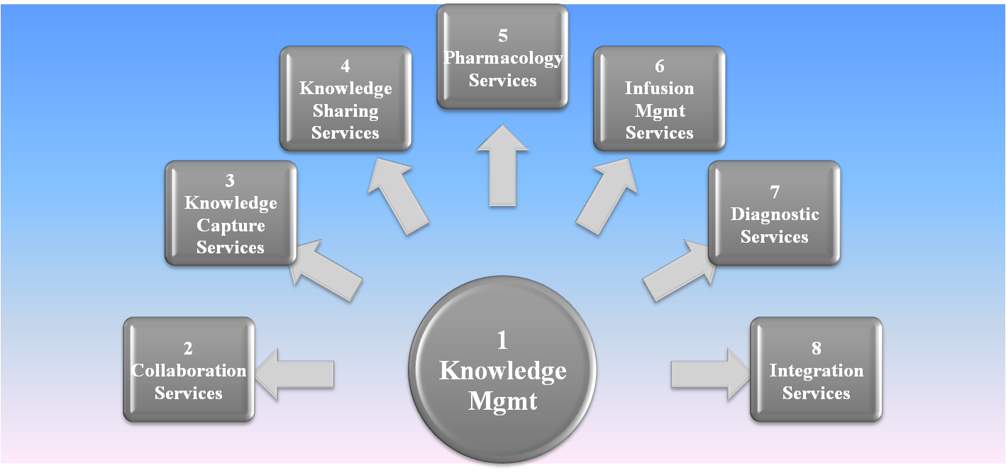









Proposal: Knowledge Driven Healthcare
Web Services
Agent Technology
Ubiquitous Computing
P2P
Machine Learning
Autonomic Computing
Proactive Computing
Distributed Computing
AI
Metadata (Taxonomies, Semantic Models, Ontologies)

Slide 11
Proposal: Knowledge Driven Healthcare
The centerpiece is the Knowledge Repository:
  A federated repository of content and data which is aligned using metadata.
  Fed by our products, internal systems, employees, external systems and automated agents.
Some of the Collaboration Services we will be able to provide include collaboration:
  Between partners
  Between suppliers & distributors
  Between patients and caregivers
  Between clinicians and pharmacists
  Using synchronous & asynchronous communications
  Delivering data, voice, video and mixed media

Slide 12
Proposal: Knowledge Driven Healthcare
Knowledge can be captured using a common set of reusable services:
  Via logical agents, machines, biologics* and systems
  Information is categorized and aligned using Metadata
  Information is cleansed, filtered and audited throughout
  Information is dynamically aggregated and mined
  * This will be possible once we shift towards technology infused drugs (nanotechnology)
Knowledge is distributed and shared using a distributed framework of component services where:
  Information is proactively delivered to resources (human, machine and/or biological) for decision support
  Decisions are made at the node level (where a node can be a device, intelligent agent, biological agent or external systems).

Slide 13
Proposal: Knowledge Driven Healthcare
Pharmacology Services
  Drug libraries will evolve into on demand pharmacology services where drugs are tuned to a patient’s demographics, genomics imprint and EMR
  Pharmacists role will evolve into consulting while the device and backend hospital systems will collaborate to form a holistic supply chain optimized for each patient
Infusion Services
  Disbursement of therapy will be managed at the bedside and within the patient via a distributed set of modules that encompass the device and drug products.
  These components act as intelligent agents, which monitor internal systems (w/in the patient) and collaborate amongst themselves and with external systems to optimize the infusion process for the patient.

Slide 14
Proposal: Knowledge Driven Healthcare
Diagnostic Services
  This area will develop more fully as we:
    optimize our monitoring capabilities (internal & external)
    learn about the body’s patterns through knowledge capture at the cellular and system level within the body
    learn more about the effect that drugs have on cells and systems within the body over longer periods of time
    Understand how to dimensionalize and synthesize the vast amount of data covering genomics, environment, demographics, patient medical records, clinical trials, and application of drug therapy across countless patients.
  This will be an organic model that may lead to whole new areas of collaboration within our products, within the healthcare supply chain and ultimately draw Hospira into an uber-grid of healthcare researchers across the world.
        (see Appendix on last page – reference attachment)

Slide 15
Proposal: Knowledge Driven Healthcare
Integration is enabled using a ubiquitous platform which provides the following services:
  Compliant with Plug-n-play standards
  Open architecture
  Integration is performed at a logical, physical and biological level
  Bindings are standardized for coupling components together so knowledge can be captured & shared
  Patterns of constraints & rules are used to perform transformations, mappings and address anomalies.
  Automated traceability, error management, self-healing capabilities are built into the framework of services.

Slide 16
Suggested Areas for Exploration
Semantic Web and Ontologies
Web Services and Semantic Web Services
(Multi) Agent Technologies
Distributed Artificial Intelligence
Meta Data & Information Architecture
Mobile Context-Aware Services and Applications
Machine Learning
Data Mining and Knowledge Discovery

Slide 17
Suggested Areas for Exploration
Ontologies which we might want to consider:
  Meta Ontologies
    Human Body (Patient)
    Healthcare Diagnostics
    Integration - HL7 Mapping (built)
    Process Model (used for delivering services)
  Domain Ontologies
    Organizational - Hospital (Customer roles & responsibilities used for delivering escalation and workflow services)
    Organizational - Hospira (Supply Chain roles & responsibilities used for delivering escalation and product support)
  Administrative Ontologies
    Basis for building a governance model
    Instrumentation, Metrics & Monitoring models
    Error Management (device diagnostics & decision-tree resolution)

Slide 18
Suggested Areas for Exploration
Models we may want to develop and/or build:
  Data Model (foundation for the framework)
  Product Model (covers the MMS spectrum)
  Service Model (portfolio of services / processes)
  Metadata Model (includes Metamodels for Rules)
Frameworks we may want to develop:
  Agile Development & Testing
  Dynamic Instrumentation & Error Management
  Data Collection & Warehousing
  Dimensional Management & Analytics Mgmt
  Data Integration
  Business Intelligence

Slide 19

Glossary
Autonomic Computing:
  It is about how to enable computing systems to operate in a fully autonomous manner.
  No administration, just simple high-level policy statements.
  It is an approach to self-managed computing systems with a minimum of human interference.
  The term derives from the body's autonomic nervous system, which controls key functions without conscious awareness or involvement.
Healthcare Research Grid
  Click on attachment

